Slide 1
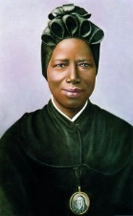
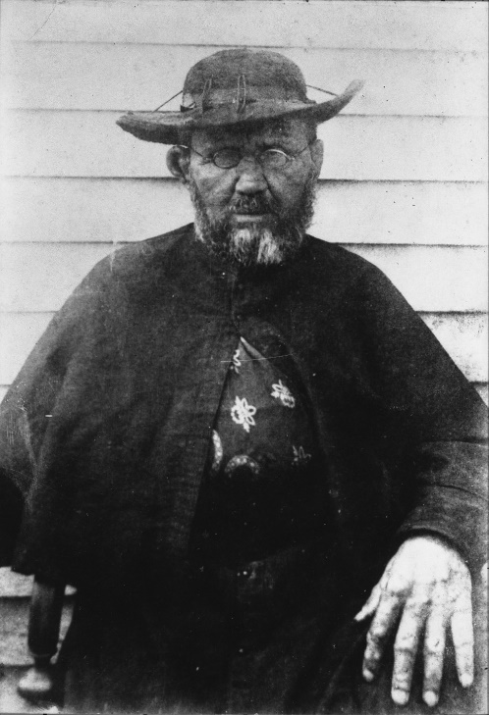
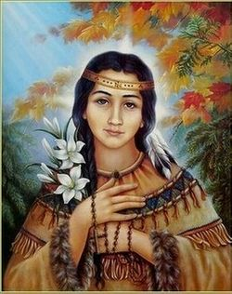
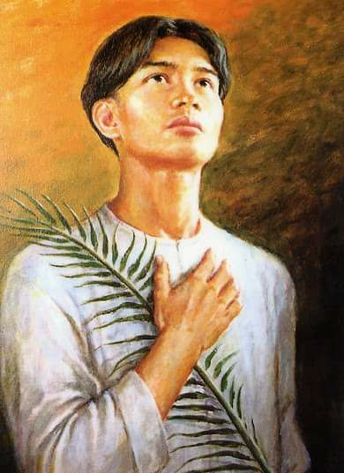
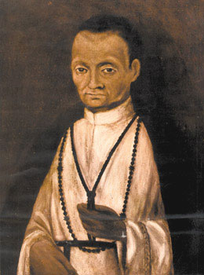
November 2020 Meeting
The Saints
Little Known
Notes:
https://www.catholiceducation.org/en/culture/catholic-contributions/what-is-a-saint.html

Slide 2
Ice Breaker
Does anyone know the names of any of those saints?

Slide 3
Before we dive into exploring these saints' lives,
let’s answer a few key questions…

Slide 4
What does it actually mean to be a saint?
A saint is a holy person who is known for his or her “heroic sanctity” and who is thought to be in heaven.
“Saints are not the opposite of sinners. There are no opposites of sinners in this world. There are only saved sinners and unsaved sinners. Thus holy does not mean "sinless" but "set-apart:" called out of the world to the destiny of eternal ecstasy with God… A saint is one who knows he is a sinner.”
– Peter Kreeft

Slide 5
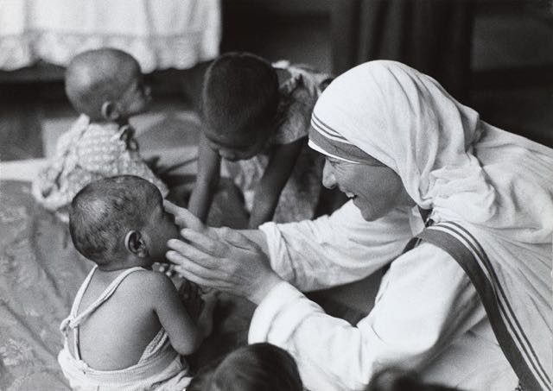
What about “Catholic saints”?
Heroic virtue + lives of holiness
Dedicated to serving God and spreading the Gospel
Some martyrs, courageously died for their faith
Show us how live closer to Christ
Reminders life will come to an end, and only what was done for Christ will have a lasting reward
Different times, different places, but shared love of God
Lives documented through the teachings of the Catholic Church.
Notes:
Heroes of the Catholic faith, practicing in the life of the Church
Lives of holiness
Dedicated to serving God and spreading his message of salvation
Some martyrs, courageously died for their faith
Serve as examples for all Catholics, showing us how to lead a more satisfying, more spiritual life in communion with our Lord and Savior, Jesus Christ.
Serve as reminders that this life will come to an end, and only what was done for Christ will have a lasting reward.
Different times, different places, but shared love of God
Lives documented through the teachings of the Catholic Church.

Slide 6
PS - No other reason other than they are adorable.
CCC 946 “What is the Church if not the assembly of all the saints? The communion of saints is the Church.
Notes:
Heroes of the Catholic faith, practicing in the life of the Church
Lives of holiness
Dedicated to serving God and spreading his message of salvation
Some martyrs, courageously died for their faith
Serve as examples for all Catholics, showing us how to lead a more satisfying, more spiritual life in communion with our Lord and Savior, Jesus Christ.
Serve as reminders that this life will come to an end, and only what was done for Christ will have a lasting reward.
Different times, different places, but shared love of God
Lives documented through the teachings of the Catholic Church.

Slide 7
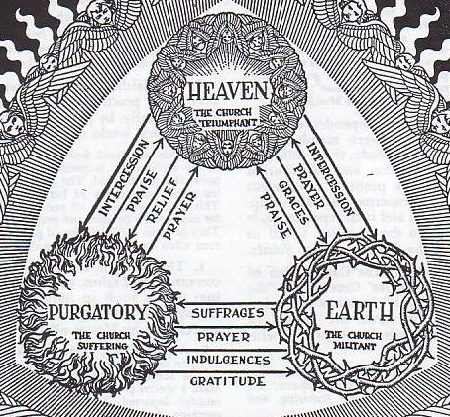
Three states of the church
CCC 962 "We believe in the communion of all the faithful of Christ, those who are pilgrims on earth, the dead who are being purified, and the blessed in heaven, all together forming one Church; and we believe that in this communion, the merciful love of God and his saints is always [attentive] to our prayers." (Paul VI, CPG § 30).
CCC 955 "So it is that the union of the wayfarers with the brethren who sleep in the peace of Christ is in no way interrupted, but on the contrary, according to the constant faith of the Church, this union is reinforced by an exchange of spiritual goods."494
Notes:
The Catholic Church commemorates the Church Triumphant and the Church Penitent in its liturgy on two consecutive days: All Saints' Day on November 1 (the Church Triumphant) and All Souls' Day on November 2 (the Church Penitent).
These terms are not used in the Catechism of the Catholic Church, an authoritative summary of the teaching of the Catholic Church published in 1994. However, the teaching these terms represent is precisely restated, quoting Lumen gentium:
The three states of the Church. "When the Lord comes in glory, and all his angels with him, death will be no more and all things will be subject to him. But at the present time some of his disciples are pilgrims on earth. Others have died and are being purified, while still others are in glory, contemplating 'in full light, God himself triune and one, exactly as he is'."^{[2]}

Slide 8
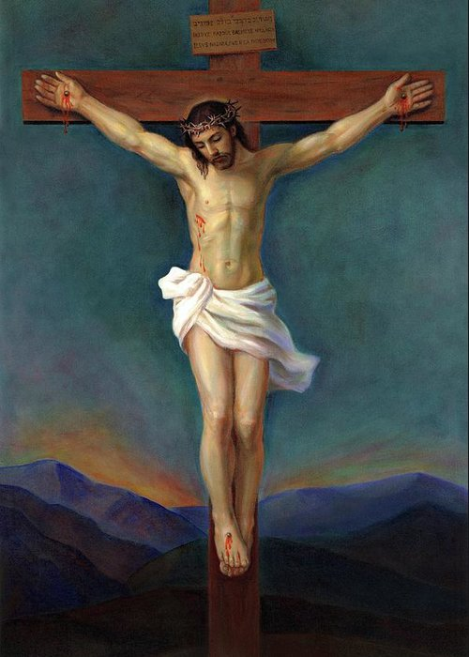
Communion in Charity (CCC 953)
"None of us lives to himself, and none of us dies to himself.“
"If one member suffers, all suffer together; if one member is honored, all rejoice together. Now you are the body of Christ and individually members of it.“
"Charity does not insist on its own way."
In this solidarity with all men, living or dead, which is founded on the communion of saints, the least of our acts done in charity redounds to the profit of all. Every sin harms this communion.

Slide 9
Opportunity for people to share…
A story about a saint’s intercession
How you’ve been able to cultivate a relationship with a particular saint
Or anything else on this topic!

Slide 10
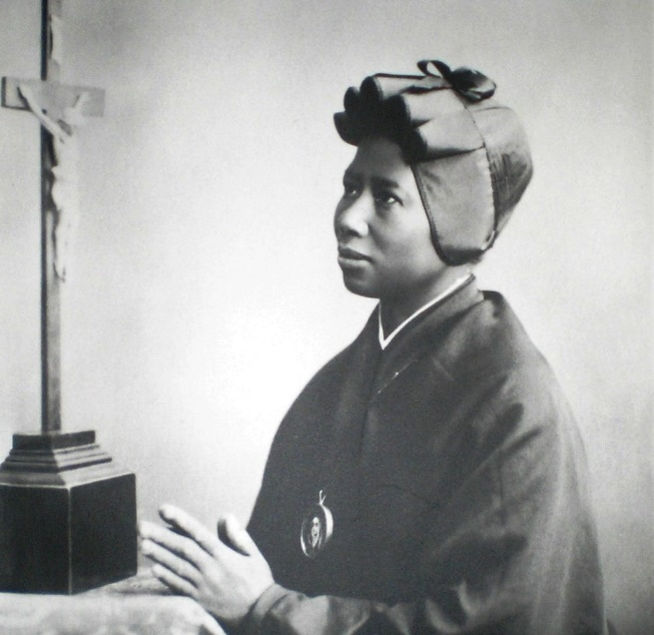
St. Josephine Bakhita
Born 1869 in Sudan to prosperous family
Seized by Arab slave traders at age 7/8 and sold over 12 times
Forced to convert to Islam
Beaten often and branded
Eventually brought to Italy by gentler owners
In 1888, owners left her in care of Canossian Sisters – first encounter with Christianity
Owners returned for her but she refused to leave and Italian court sided with her
Baptized in 1890 by future Pope Pius X and in 1896 she became a Canossian sister.
She was assigned to convent in Schio, in northern Italy where she worked for next 42 years
Died on 2/18/1947 and canonized on 10/1/2000

Slide 11
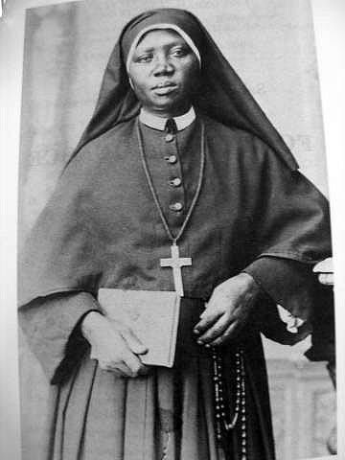
St. Josephine Bakhita
Quotes
"If I were to meet those who kidnapped me, and even those who tortured me, I would kneel and kiss their hands. For, if these things had not happened, I would not have been a Christian and a religious today".
"As the Master desires."
"Yes, I am so happy: Our Lady ... Our Lady!"
https://www.youtube.com/watch?v=nwbOZGfJYQ4

Slide 12
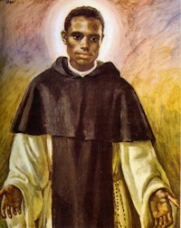
St. Martin de Porres
12/9/1579 – 11/3/1639
Patron saint of mixed-race people, barbers, innkeepers, public health workers and all those seeking racial harmony
https://www.youtube.com/watch?v=FcW69Jyof5w

Slide 13
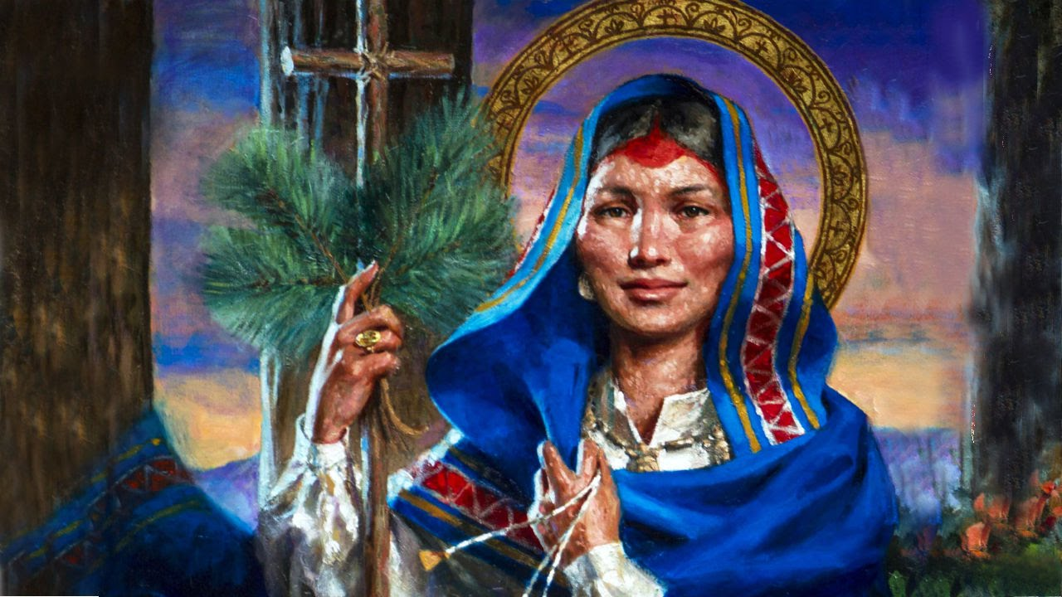
St. Kateri Tekakwitha
1656 - 1680
First Native American to be canonized.
https://www.youtube.com/watch?v=Q-avAU1UVkA

Slide 14
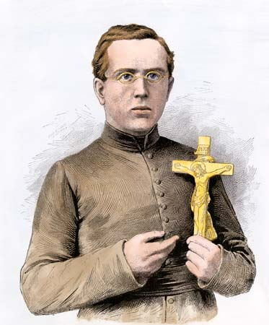
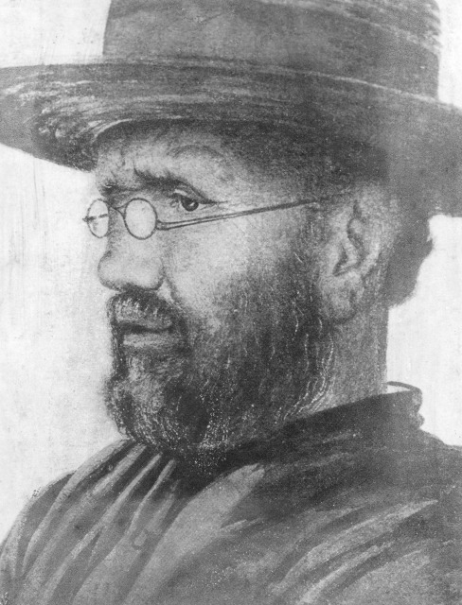
St. Damien
https://www.youtube.com/watch?v=MbDY4ANWW8M

Slide 15
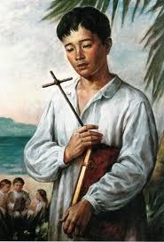
St. Pedro Calungsod
Canonized by Pope Benedict XVI on October 21, 2012
https://www.youtube.com/watch?v=W1MRI_KpcnU

Slide 16
Which one do you relate to? What could we learn from them in 2020? Anyone to add?

Slide 17
Vote on NCC Patron Saint!
(Gina to share document)

