Slide 1
Rites of the catholic church
NCC Monthly meeting – August 6, 2020

Slide 2
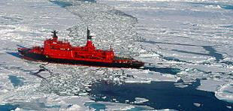
Notes:
Guess the name of the rite or Church based on the syllables pictured!

Slide 3
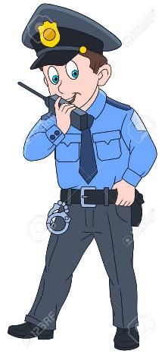
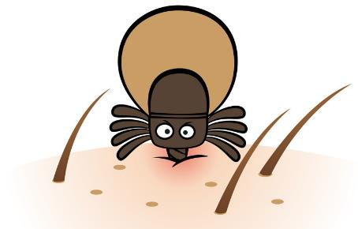
Notes:
Coptic

Slide 4
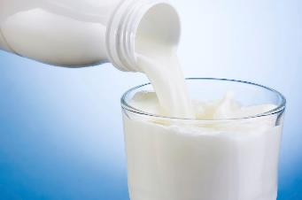
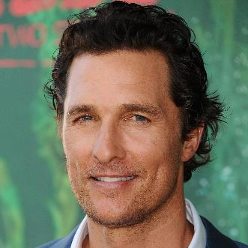
_____, ______, _____!
first 3 letters
Notes:
Melkite

Slide 5
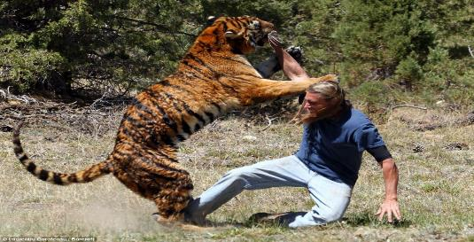
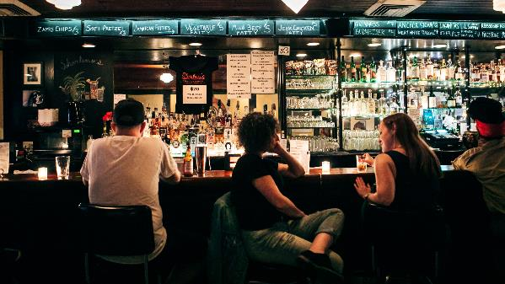
Notes:
Syro-Malabar

Slide 6
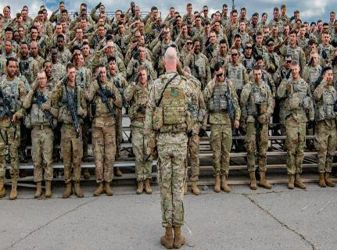
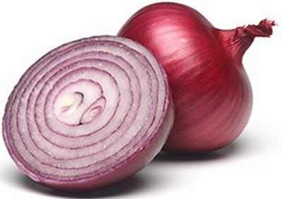
O
Notes:
Armenian

Slide 7
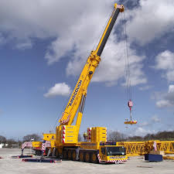
O
Notes:
Ukrainian

Slide 8
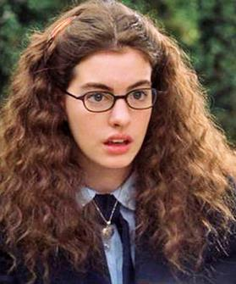
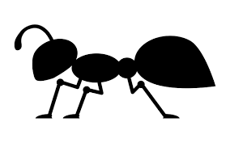
Notes:
Byzantine

Slide 9
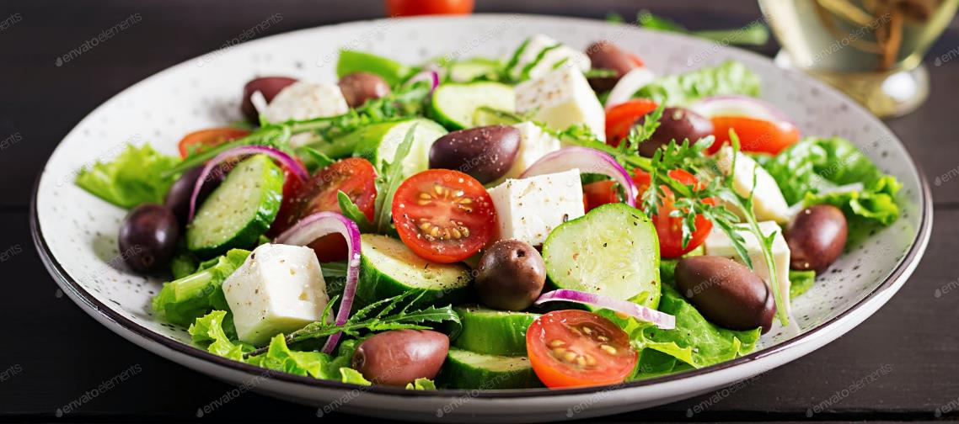
Notes:
Greek

Slide 10
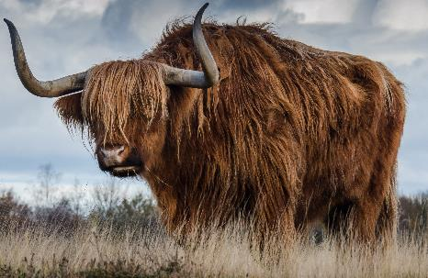
Notes:
Syriac

Slide 11
Opening prayer
Matthew 13:31-32
Notes:
Volunteer to read? Lord we pray that you open our hearts tonight as we learn about the diverse branches of our Church. May we appreciate the ways in which culture has inspired each unique rite and recognize that though we are many parts, we are one body of believers rooted in our faith in you. Took this parable for the slide background too, with the slide design looking like the branching out of a tree ☺ but the general idea here is like the mustard seed started small and branched out, so Catholicism started out with Jesus and Company and branched out over the years into various rites.

Slide 12
Liturgical diversity and the unity of the mystery
“From the first community of Jerusalem until the Parousia, it is the same Paschal mystery…celebrated in the liturgy…but the forms of its celebration are diverse.” (CCC 1200)
“The mystery of Christ is so unfathomably rich that it cannot be exhausted by its expression in any single liturgical tradition.” (CCC 1201)
“The celebration of the liturgy, therefore, should correspond to the genius and culture of the different peoples. In order that the mystery of Christ be ‘made known to all the nations…to bring about the obedience of faith,’ it must be proclaimed, celebrated, and lived in all cultures in such a way that they themselves are not abolished by it, but redeemed and fulfilled…” (CCC 1204).
Notes:
Before we get into the many different rites and what makes each one unique, thought it would be good to mention what they all have in common. CCC has a few references to the rites, mostly emphasizing unity in diversity. Bolded important parts for ease of reading, volunteers to read?

Slide 13
Liturgical diversity and the unity of the mystery
“The diverse liturgical traditions have arisen by very reason of the Church’s mission. Churches of the same geographical and cultural area came to celebrate the mystery of Christ through particular expressions characterized by the culture: in the tradition of the “deposit of faith”, in liturgical symbolism, in the organization of fraternal communion, in the theological understanding of the mysteries, and in various forms of holiness. Through the liturgical life of a local church, Christ, the light and salvation of all peoples, is made manifest to the particular people and culture to which that Church is sent and in which she is rooted. The Church is catholic, capable of integrating into her unity, while purifying them, all the authentic riches of cultures.” (CCC 1202)
Notes:
Some of you may have heard before that the word catholic means universal, open to all. Goal is not to replace the culture, but to take the best of the cultures and integrate it into faith. What we will explore for each rite tonight is the center bolded portion (deposit of faith, liturgical symbols/key figures, community emphasis, theological understandings of the mysteries of the faith).

Slide 14
Liturgical diversity and the unity of the mystery
“In the liturgy, above all that of the sacraments, there is an immutable part, a part that is divinely instituted and of which the Church is the guardian, and parts that can be changed, which the Church has the power and on occasion also the duty to adapt to the cultures of recently evangelized peoples.” (CCC 1205)
“Liturgical diversity can be a source of enrichment, but it can also provoke tensions, mutual misunderstandings, and even schisms. In this matter it is clear that diversity must not damage unity. It must express only fidelity to the common faith, to the sacramental signs…and to hierarchical communion. Cultural adaptation also requires a conversion of heart and even, when necessary, a breaking with ancestral customs incompatible with the Catholic faith.” (CCC 1206).
Notes:
The first point is probably my favorite part about the Church – no need to go church hopping when you go on vacation, because if you see a Catholic Church, you essentially know the format, the beliefs, the credibility, etc. Language might be different in addition to minor liturgical practices, but overall such an emphasis on the universal Church. Second point is one of the few points in the CCC that doesn’t focus on the unity in diversity of the rites. It’s applicable to modern day Church and even the past Churches in that when certain cultural practices contradict the way Christ wants us to live, we have to go by the Catholic way, not the human culture.

Slide 15
Further reading
Orientalium Ecclesiarum
Ut Unum Sint
Orientale Lumen
Notes:
Ut unum sint and Orientale Lumen – Apostolic Letters from JPII about ecumenism and Christian unity
Orientalium Ecclesiarum – Paul VI wrote this decree stating Eastern Churches’ unity w/West, emphasis on their dignity. Specifies role of Patriarch (basically archbishop, responsible for ordaining bishops in their rite and establishing new dioceses’, also details Eastern rite Catholics’ ability to get sacraments at any other rite. Important because many of the Eastern rite Churches are smaller, so not all areas may have a Church from their native rite.

Slide 16
commonalities
Pope = Head of the Church
Dogmas and Doctrines of the Catholic Church per Magisterium
7 Sacraments*
Bible canon
Marian devotion
Saints
Feast days
Icons
Church-hopping Catholic – style!
Notes:
Apostolic See responsible for determining major feast days (individual churches may add their own, like patron saint of the parish feast days). Major feast days would be Christmas, Easter, etc. that are mandatory and individual Churches can’t just opt out of celebrating.
Patriarch blesses Chrism, priests of Eastern Churches can give all 3 sacraments to people of East and Western rite churches. In Eastern rite churches, Baptism, First Communion, and Confirmation are typically all performed at the same time in infancy, so priests are used to giving Confirmation. In Latin (Western/Roman) rite, bishops give Confirmation, priests give Baptism and First Communion. Eastern rite priests can hear confessions of any rite in his bishop’s area, Sunday Mass at any Catholic rite church counts toward obligation ☺ → again the idea that not all parts of the world have a Church of the person’s usual rite, flexibility helps practice the faith.

Slide 17
Crash course
Which Type of Catholic Are You? – Fr. Casey, OFM, Breaking in the Habit
Notes:
Overview of the 24 different Churches within the global Catholic Church. Fr. Casey has a Youtube channel called Breaking in the Habit (because he’s a Franciscan friar ☺ ). Very informational content…like a Bishop Barron or Fr. Mike Schmitz in the delivery of his content.

Slide 18
Rite vs. church
“Canon 27 – A group of Christian faithful united by a hierarchy according to the norm of law which the supreme authority of the Church expressly or tacitly recognizes as sui iuris is called in this Code a Church sui iuris.
“Canon 28 – A rite is the liturgical, theological, spiritual and disciplinary patrimony, culture and circumstances of history of a distinct people, by which its own manner of living the faith is manifested in each Church sui iuris.”
~1990 Code of Canons of Eastern Churches
Notes:
Sui iuris → the churches govern selves w/ their own canon law that falls under main catholic canon law

Slide 19
Armenian
Armenian
Notes:
Expanded version of chart from Fr. Casey’s video. He omitted the Armenian rite, so I added it in. Ruthenian Church → Ruthenia was the pre-World War 1 name for Slovakia, Hungary, and Croatia.

Slide 20
Notes:
Major cities that each rite branched out from in yellow, Saints/Apostles responsible for spreading the rite in green underneath the city name. In black area, pale green = name of each rite and white = name of churches included in that rite.

Slide 21
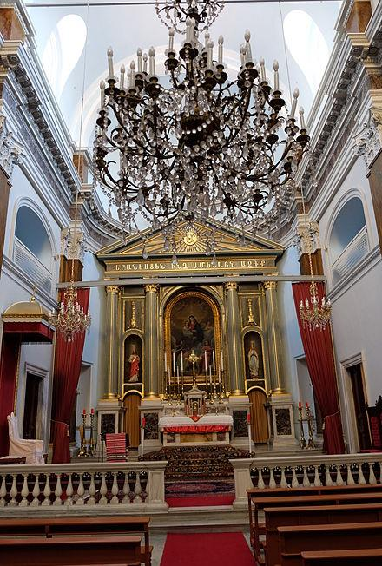
armenian
Churches → Armenian
Notes:
Note the red curtain here! Will explain its use in subsequent slides

Slide 22
armenian
Local Churches* → Holy Cross Armenian Catholic Church (Belmont)
Languages → Ancient Armenian
Key Saints → St. Gregory of Narek, St. Gregory the Illuminator, St. Mesrob Mashdotz, St. Nerses Klaietsi, Blessed Gomidas Keumurgian, Blessed Ignatius Shoukrallah Maloyan
Unique Feasts
Exaltation of the Holy Cross
St. Gregory the Illuminator
Aratchavorats → 6-8 week long Advent*
2 week long Fast of Nineveh* between Epiphany and Bahots (Lent)
Notes:
Armenian CC mainly in US, Canada, France, and Lebanon today (obvi Armenia too)
Ancient Armenian is significantly different from modern-day spoken Armenian
*St. Gregory Narek → Doctor of the Church
*St. Gregory Illuminator → wrote liturgy in Syriac, St. Mesrob translated to Armenian
*Nerses→ tried to reunite Orthodox Greeks to CC
*Ignatius → martyr during Armenian Genocide, clergy murdered before him before he was too for not converting to Islam
*Advent → starts w/ Christ the King feast day
*Feast during period in between Epiphany and Lent, Fast of Nineveh is 2 weeks within this feast time frame. If you think about it, Jonah was in the belly of the whale for 40 days and nights before going to Nineveh, and Lent is a period of fasting for 40 days and nights, so it makes sense that the Fast of Nineveh leads up to Lent

Slide 23
armenian
Major Points of Distinction
Patriarch a.k.a. Petros → Catholicos Patriarch of Cilicia of Armenian Catholics
Liturgy of St. Gregory the Illuminator*, Divine Liturgy = Mass*
Antidoron* = “blessed bread”, but not consecrated
Curtains separate Sanctuary from congregation, priest wears crown
Council of Nicaea remembered during Liturgy
Weekday Holy Days → following Sunday
The only Church restricted to one people, language, and alphabet
Other rites usually encompass multiple nations, languages, and ethnic groups
Notes:
*St. Greg Liturgy → same format as Latin Rite Mass, but has slightly different prayers
*3 parts to Mass: Preparation (start to end of Preface), Anaphora/Canon (Preface to Communion) Conclusion.
*Antidoron = extra bread handed out to people after Mass for fellowship, not consecrated. Consecrated unleavened hosts go into Tabernacle, like Latin rite.
*Post recitation of Creed, the sentence from the council is prayed. “Those who say there was a time when the Son was not, or when the Holy Ghost was not; or that they were created out of nothing; or that the Son of God and the Holy Ghost are of another substance or that they are mutable; the Catholic and Apostolic church condemns.”
*except Christmas, Epiphany, and Ascension celebrated on the day of the feast itself…not rounded up to Sunday
*

Slide 24
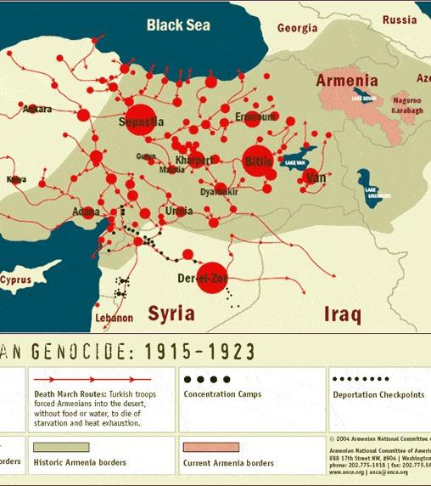
armenian
Historical Notes
Armenian Genocide → post WWI massacre of Armenians by Ottoman Empire, mostly Christians
Council of Chalcedon, 451 → Armenian church split off, partially reunited in Cilicia in 1198, not fully reunited until 1740*
Interesting Reading
Pope Francis Recalls Slaughter of Armenians in ‘First Genocide of the 20th Century’, NCR
The Eastern Catholic Churches by Fr. Ronald Robertson
The Book of Prayers by St. Gregory of Narek
Armenian Catholic Eparchy of Nareg – US and Canada Diocese for Armenian CC
Notes:
1740 → Abraham Petros I Ardzivian reunited Armenia fully Rome

Slide 25
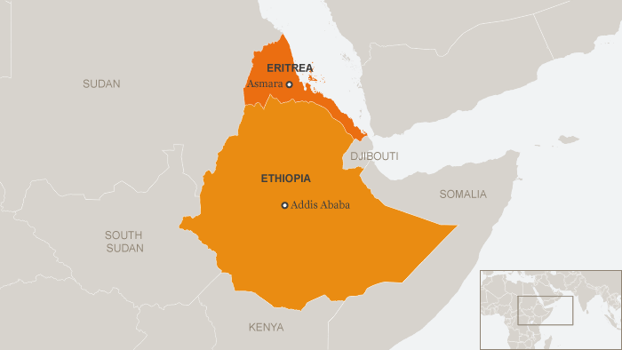
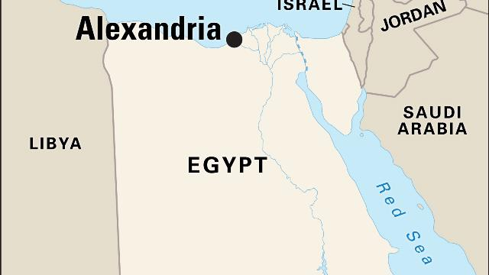
Alexandrian
Churches → Coptic, Ethiopian, Eritrean

Slide 26
Alexandrian
Local Churches → Coptic (LA, Nashville, Egypt), Ethiopian, Eritrean (Eritrean Holy Family Ge’ez Rite Catholic Community of Chicago)
Languages → Coptic, Arabic, Ge’ez (Amharic in Ethiopia, Tigrigna in Eritrea)
Key Saints → St. Athanasius of Alexandria, St. Frumentius, St. Justin de Jacobis, Blessed Michael Gabra
Unique Feasts
September end → beginning of church year w/ Feast of the Cross
Multiple fasting periods
Apostles’ Fast → Pentecost to Feast of Sts. Peter and Paul
Lent → stricter than Latin or Byzantine rites, fasting starts before Ash Weds. and Clean Mon.
Notes:
Coptic Catholic NOT the same as Coptic Orthodox, Eritrean CC in Chicago isn’t its own parish…it borrows a Roman Catholic parish for a monthly Mass in Ge’ez
Ge’ez like Latin, mainly liturgical language, not spoken. Amharic and Tigrigna are vernacular versions of Ge’ez
Athanasius → Doctor of the Church, ordained Frumentius as bishop of Aksum (northern Ethiopia/Eritrea),
Justin → ordained Michael Gabra (convert to Catholicism in 1844), Justin and Michael wrote Catechism of Christian doctrine adapted for local church
Gabra → translated moral theology into Amharic
Frumentius → Kesate Birhan, “Revealer of Light”, brought Chrisianity to Aksum kingdom in 4th c

Slide 27
Alexandrian
Major Points of Distinction
Founder → St. Mark the Evangelist (Coptic), Sts. Matthew, Bartholomew, Frumentius (Ethiopia, Eritrea)
Ethiopian → drums used in liturgy, women may “ululate” in worship during points in the Mass
Eritrean → no major liturgical differences, unleavened host
Communion → Dip host into blood first (intinction) before administering on tongue. Blessing w/ Sacred Species.
Sacraments of Initiation → all @ same time
God cannot be depicted in icon
Notes:
Video stop at 1:30. You’ll have heard drums and ululation by that point.
Copts used to ordain 1 bishop for Ethiopia, liturgies super different even though both Alexandrian rite churches 3-5 hr Ethiopian liturgy

Slide 28
alexandrian
Historical Notes
Coptic → Orthodox Church breaks off after Council of Chalcedon in 451, reunifies in 1741 w/ Bishop Anba Athanasius’ reversion
Ethiopian → Reunited w/Rome in 1849
Eritrean → Formed in 2015 after branching off from the Ethiopian Church
Interesting Reading
Coptic → Amir’s Choice, Coptic Christian Persecution, Rebaptism of Coptic Christians
Ethiopian/Eritrean → The Beauty of the Eritrean Catholic Church

Slide 29
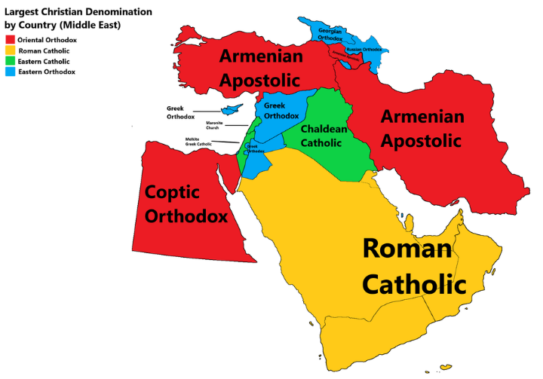
Antiochean
3 Rites
Byzantine
East Syriac
West Syriac

Slide 30
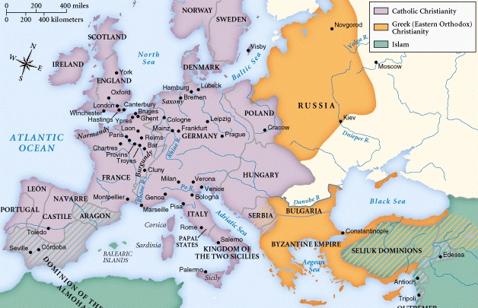
byzantine
Churches → Albanian, Belarusian, Bulgarian, Croatian/Serbian, Greek Byzantine, Hungarian, Italo-Albanian, Macedonian, Melkite, Romanian, Russian, Ruthenian, Slovak, Ukrainian
Known as Greek Catholic ___ Church
Ruthenian = Byzantine Catholic Church in USA
Notes:
Byzantium renamed Constantinople by Constantine when he split the roman empire in four
Alexandria – Coptic city, Antioch – Syriac and Aramaic, Jerusalem – city of Jesus, Rome – Latin and Greek, Constantinople – for byzantine, est’d in 324 before council of Nicaea
Andrew, Mark (copts), Peter, James (Jerusalem), Peter (rome and Antioch)
Differ from Orthodox Church by calling themselves i.e. Albanian Greek Catholic Church, Ukrainian Greek Catholic Church

Slide 31
byzantine
Local Churches* → Christ the King Ukrainian Church (JP), Sts. Cyril and Methodius and St. Raphael’s Croatian Catholic Church (NY), Our Lady of the Annunciation Melkite Catholic Cathedral (West Roxbury)
Languages → Based on ethnic group
Key Saints → St. Josaphat Kuntsevych (Ukrainian, Belarusian), “Equal to the Apostles”: Sts. Cyril and Methodius, Olga and Vladimir of Kiev
Unique Feasts
Liturgical year starts September 1
12 Great Feasts → vary by Church, focused on events in Mary and Jesus’ life
Ukrainian Liturgical Calendar
Clean Monday and Lazarus Saturday*
November 12→ St. Josaphat Kuntsevych, martyr
Notes:
Clean Monday = Great Fast begins, start of Lent (week of Ash Weds). Lazarus Saturday = resurrection of Lazarus day before Palm Sunday. Passion Week = Holy Week, not included in Great Fast or Lent
Byzantine churches collab on catechetical text.

Slide 32
byzantine
Major Points of Distinction
Mass = Holy Sacrifice, Eparchy = diocese, Sacraments = mysteries
No difference between private and public prayer
3 Liturgies → Divine Liturgy of St. John Chrysostom, except during Lent (Basil the Great or Presanctified)
No daily Mass
Sacraments of Initiation at same time
Communion = tongue only, intinction, leavened bread, spoon
Good Friday → veneration of Jesus’ burial cloth
Veneration of icons
Incense whole congregation first, Gospel carried around the Church
Notes:
-Mass on Sundays and holy days (i.e. Annunciation) during Lent. Presanctified Liturgy every Weds. + Fri. of Lent. Latin Rite’s Presanctified Liturgy on Good Friday.
-Communion = consecrated bread cut up w/a spoon and mixed into chalice, mouth open but no tongue sticking out, communion admin’d w/a spoon. For babies, priest dips pinkie in chalice and gives them.
-Artos = leavened bread in greek, found in the last supper story
-Azimos = unleavened bread in Greek,not mentioned in gospel
-Most Eastern churches use leavened bread, western uses unleavened → unleavened recalls matzo in seder, probs just easier to store, leavened bread expires faster. Of the Eastern churches, Chaldean, maronite, Syrian catholic, Armenians = all use unleavened bread
“secret prayers” → main diff btwn John and Basil liturgies, not secret, the priest just whispers them in
Theotokos → at anaphora’s end after epiclesis/ prayer to holy spirit (Basil = In you, O Full of Grace, all creation rejoices) (John = It is fitting and right to call you blessed, O Theotokos…)
Basil → used 10x/yr : Christmas, New Year’s/Basil feast day, 1st 5 sundays of lent, holy Thursday, holy saturday

Slide 33
byzantine
Major Points of Distinction
Divine Liturgy fully sung, standing
Sign of Cross → R to L, first 3 fingers together (Trinity) and remaining 2 pressed to palm (Christ’s humanity and divinity)
Priest blessing congregants → ICXE shape
Epiclesis, not transubstantiation or words of institution = liturgical focus
Notes:
ICXE = Jesus Christ in Greek, ring finger pressed against palm, thumb ontop of ring knuckle, remaining 3 fingers up straight
Epiclesis = prayers for descent of Holy Spirit, holiest moment of the Liturgy

Slide 34
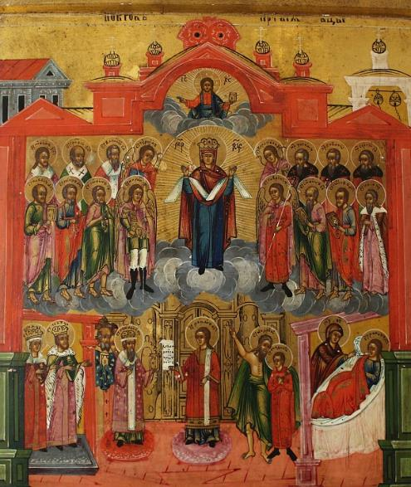
Byzantine iconography
Luke 8:17
“Written” like Scriptures not painted, not just an image or a painting, not just to teach illiterate people the Scriptures
“…an image is not usually equal with what it represents; but, in fact, we know that Christ, as the image or icon of the Father, is identical with the Father in every particular, differing from Him only by the fact of being begotten”
~ St. John of Damascus
Venerate as if truly in God’s presence
Notes:
Pokrov Icon located in the Heritage Center of the Eparchy of Passaic (USA East Coast). Description below as per Eparchy of Passaic website.
“Based on a vision St. Andrew the Fool for Christ had on 10/1/0911 of Mary, St. John the Forerunner and St. John the Beloved Disciple entering Church of Blachernae. In the vision, Mary prayed at the ambo and altar before taking off her veil and spreading it out in protection of Constantinople. The Mother of God is in the center of the icon with her veil spread out as a symbol of her motherly protection of the city, and her arms raised in the “orans” posture, the prayer posture of the early Christians. Above her is Jesus Christ blessing with his right hand and holding a book in his left hand.
Starting from the center of the icon and moving outwards to our left, in the middle row, St. Michael the Archangel is closest to the Theotokos, then St. John the Forerunner (the Baptizer), then St. Peter the Apostle, St. Paul the Apostle. Above St. Michael is St. Uriel the Archangel, and next to him is St. Basil the Great, then St. Gregory the Theologian, and St. John Chrysostom (not the usual portrayal of him).
Starting from the center of the icon and moving outwards to our right, in the middle row are St. Gabriel the Archangel, St. John the Theologian (the Evangelist and Beloved Disciple), St. James the Apostle, and the Holy Prophet Elijah. Above St. Gabriel is St. Barachiel the Archangel, then the Monks St. Zosimus, St. Savvaty, and St. Sergei.
On the bottom row, St. Romanos the Melodist is in the center of the icon. Moving outwards to our left, the one closest to St. Romanos is the Patriarch St. Gennadius, then Emperor Leo the Wise and his wife Zoë.
Moving in the other direction from the center next to St. Romanos is St. Andrew the Fool for Christ pointing to the Theotokos for the benefit of St. Epiphanios his disciple. Finally, in the lower corner of the icon is the Mother of God appearing to St. Romanos on his sick bed, bringing him healing and his vocation as a songwriter.”

Slide 35
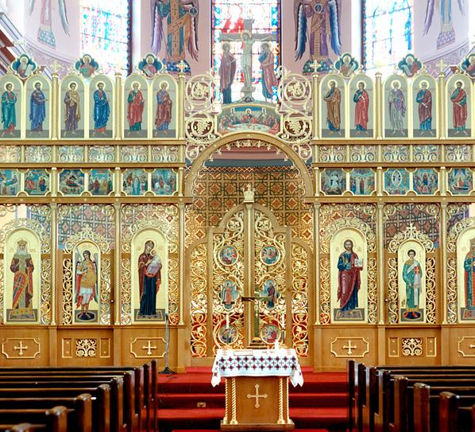
Byzantine iconography
Recycled structures approved by religious authoritiy throughout icons
Nonsmiling, passionless faces
Images reflect how things look from God’s perspective
“Bring us into dialogue with divine reality”
Notes:
-Artist doesn’t just make up the icon through wild imagination/inspiration/artistic liberties, things have to be depicted a certain way
-Iconostasis from Ukrainian GCC in Canada pictured. Iconostasis = screen between Holy of Holies and congregation. Resembles structure of OT temple in Jerusalem, featured in all Byzantine churches.
-OT Temple = wall, rod of Aaron, manna, 10 Commandments, screen dividing Holy of Holies from worshipers
-Byz Church = sacrificial altar, cross behind altar, Eucharist, Bible, iconostasis

Slide 36
byzantine
Historical Notes
Cyril and Methodius created Glagoitic Slavic alphabet
1054 → The Great Schism split East from West Catholic Church
1596 → Union of Brest reunited Ukrainian Rite
1646 → Union of Uzhorod reunited Hungarian, Ruthenian, Slovak Rites
WWII and Stalin wiped out most Byzantine churches, esp. Ukrainian
Interesting Reading
Christ Our Pascha
Introduction to the Byzantine Rite by Archbishop Joseph Raya
Byzantine Daily Worship by Archbishop Joseph Raya and Baron José de Vinck
"La prière des Chrétiens d'Orient" by E. Lanne
"On Defense of Holy Iconography " by St. John of Damascus
Notes:
Spring 1945 → Stalin gave all Ukrainian Catholic lands to Russian Orthodox church and sent Ukrainian bishops to forced-labor camps, UGCC went underground
1054 – Great Schism, papal legate of Rome sent to Constantinople after Pope died, excommunicated patriarch of Constantinople but didn’t know Pope died, laid bull of excommunicated on Hagia Sophia altar. Nothing much changed until fourth Crusade, sacking of Constantinople (Crusaders coming home after defeat and were welcomed into Constantinople by locals thinking they were fellow Christians, but then Crusaders sacked the place)
1965 → end of Byzantine excommunication, reunited w/Rome on Mount of Olives

Slide 37
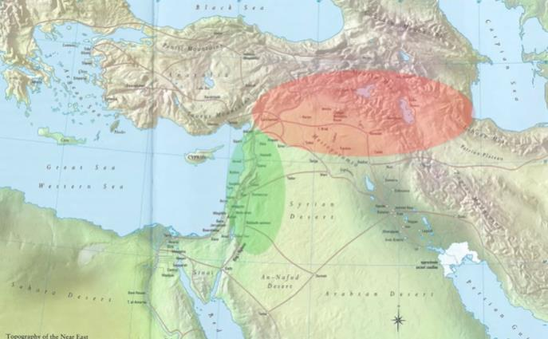
Moving on to east and west syriac
West Syriac
East Syriac
Notes:
Not a typo, East Syriac is closer to the sea and West Syriac is the red region ☺

Slide 38
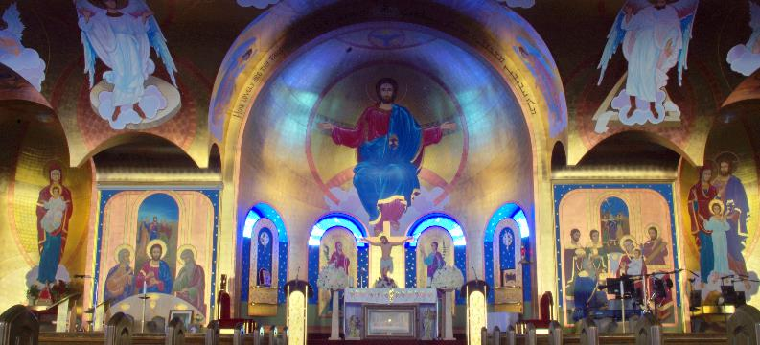
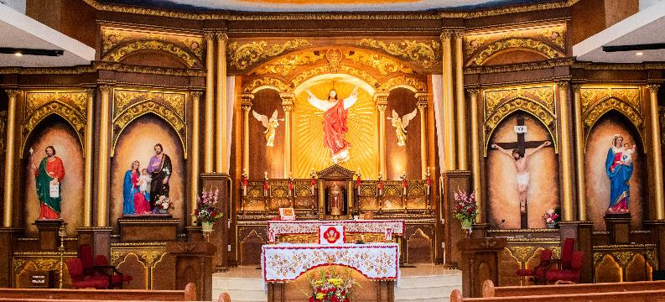
East Syriac
Churches → Chaldean & Syro-Malabar
Notes:
St. Joseph Chaldean Catholic Church in Troy, Michigan (top) and St. Thomas Syro-Malabar Catholic Church in Philly (bottom)
Note 2 podiums on either side of altar, one to read OT Scriptures at and other to read NT Scriptures at. Mini altar in front of the main altar in Syro-Malabar Church is to read the Gospel at. Main altar is for celebrating Eucharist.

Slide 39
East syriac
Local Churches → Chaldean Mission Church (Newton Upper Falls), St. Thomas Syro-Malabar Church (Framingham)
Languages → Syriac/Aramaic, Arabic (Chaldean), Aramaic and Malayalam (Syro-Malabar)
Key Saints → Mar Addai of Edessa, Mar Mari, Servant of God Ragheed Ghanni(Chaldean), St. Alphonsa (Syro-Malabar) St. Thomas the Apostle (both)
Unique Feasts
No Ordinary Time
Apostles’ Fast → June
Seasons of Moses and Elijah → September and October
Feast of St. Thomas the Apostle → July 3, HDO
Notes:
Mar = St. Sts. Thaddeus Addai and Mari were disciples of St. Thomas. Thaddeus founded ancient Assyrian Church. Patriarchate in Baghdad. Diocese = Eparchy. Michigan has the largest Chaldean Catholic population outside of Iraq.
*Ragheed Ghanni → not yet canonized, but important Chaldean Catholic priest, killed in 2007 after celebrating Qurbana by Islamist fighters who wanted him to convert
*St Thomas → arrived in Kerala in 52 ad. Syro-Malabar church joined with Assyrian (Nestor) church in 5th c.
*St. Alphonsa → 1st Indian saint, fell into chaff pit at 13, burned her feet and permanently disabled, left her wealthy family and joined Franciscan Clarist nuns

Slide 40
East Syriac – major points of distinction
Chaldean
Syro-malabar
Liturgy of Salvation/Sacrament/Sacrifice/Eucharist/Anaphora= Mass (Chaldean)
Chaldean Mass has 3 parts: Order of Word, Sacrifice, and Eucharist
Jewish* roots of prayers
Patriarch of Babylon of the Chaldeans
Holy Qurbana = Mass (Syro-Malabar)
Communion = unleavened bread, intinction
Red curtain separating Sanctuary from congregation
Anaphora = Eucharistic prayer
Liturgy of Mar Addai and Mar Mari
Notes:
*Jewish roots → final blessing at Mass doesn’t mention God by name b/c Jews wouldn’t. “He who blessed us” → “God who has blessed us” but translated into Some aspects are maintained in Chaldean but lost when translated to Arabic. “The Holy is fit for the saints” → “The Holy Communion is worthy of saints”
Holy Qurbana → Priest faces altar, huge cross present, shoes outside church, women and girls all veiled, altar server helps congegation say responses, mostly sung responses, St. Thomas mentioned repeatedly
Hyperlink takes you to an English version Holy Qurbana at the Syro-Malabar Church in Chicago. Watch it to see how different the liturgy is!

Slide 41
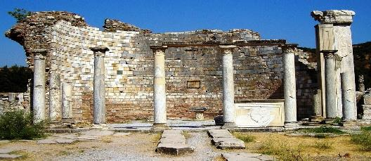
East syriac
Historical Notes
Needed own rite b/c early Assyrian Church’s isolated in Sassinian, not Roman Empire
Council of Ephesus in 431 →Split b/c over Nestorius* beliefs, Catholics followed Ephesus,* reunited as Chaldean Catholic Church in 900s
1498 → Portuguese missionaries find Syro-Malabar Catholics in addition to their Roman Catholic ones
1599 → Synod of Damper reunites Syro-Malabar rite
Pope Leo XIII and Pius XI revival*
Interesting Reading
Prayers of the Chaldean Church – free English downloads!
Chaldean Patriarchate of Babylon
Notes:
*Nestorius → Jesus = 2 people, human and divine
*Ephesus → Jesus = 1 person, human and divine
*of East Syriac rite, now second largest eastern CC is Syro-Malabar
Chaldean Patriarchate of Babylon → multiple articles related to news in Chaldean Church

Slide 42
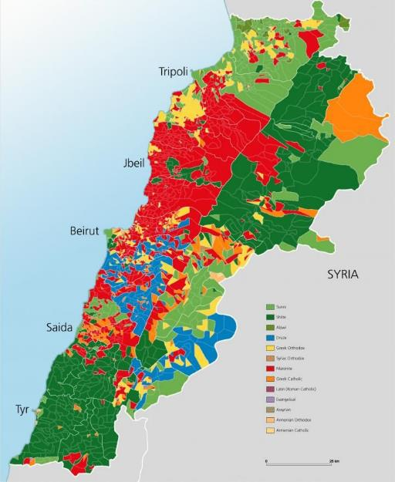
West Syriac
Churches → Maronite, Syriac, Syro-Malankara
Notes:
*Rite spread out from Antioch, red parts are Maronite church in Lebanon today

Slide 43
West syriac
Local Churches → St. Anthony of Desert (Fall River), Our Lady of the Cedars of Lebanon (JP), St. George Maronite (Cranston), St. Theresa’s (Brockton), St. Peter’s Malankara (NY), St. Brigid’s (Lexington) Our Lady of Deliverance (Newark)
Languages →Aramaic and Arabic (Maronite), Aramaic/Syriac (Syriac), Malayalam and English (Syro-Malankara)
Key Saints → St. Maron and St. Charbel Makhlouf, St. Rafqa Pietra Choboq Ar-Rayes (Maronite), St. Ephrem the Syrian (Syriac)
Notes:
*St. Maron = John Chrysostom’s friend
*Charbel = monk
*Rafqa = Rebecca, basically became nun despite her parents setting up an arranged marriage for her, like Mother Teresa, she took on Christ’s suffering joyfully
*Ephrem = dr of church

Slide 44
West syriac
Major Points of Distinction
Maronite → 1 of 2 Eastern CC’s that never split from Rome
Syro-Malankara → reunited subgroup of Malankara Orthodox Syrian Church
Holy Qurbana = Mass
Various Maronite anaphora, usually Anaphora of 12 Apostles
Anaphora of Mor Yacob
Notes:
*Syro Malabarese that didn’t want to reunite w/Rome formed Orthodox Syro-Malankara. Over centuries, eventually more similar to E. Syrian than W. Syriac rite
*Mor Yacob = St James
-Maronite uses unleavened bread
-Syriac uses unleavened bread

Slide 45
West syriac
Historical Notes
Maronite → moved from Syria to Lebanon to escape Muslim persecution
Council of Chalcedon → Maronite stays CC, Syriac splits
1182 → Maronite CC reconfirms unity w/Rome
1781 → Syriac CC reunites w/ Rome*
1829 → Ottoman Empire allowed Armenian and Syriac CC freedom of worship
1930 → Syro-Malankara CC reunites w/ Rome
Interesting Reading
Syro-Malankara Lectionary
Notes:
*Aleppo Orthodox patriarch dies, Syriac CC can reunite

Slide 46
Saving the best-known for last…

Slide 47
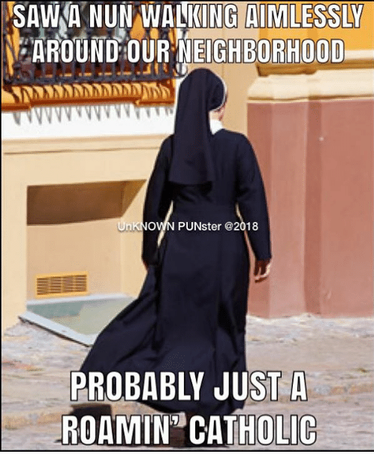
Latin/ROman
Churches → Latin/Roman Catholic Church (seriously, that’s it)

Slide 48
Latin/roman
Local Churches → We live in New England, they’re
Languages → English, Latin, Spanish, Haitian Creole, Portuguese, Vietnamese, and more!
Key Saints → Mary, the 12 Apostles, Matthew, Mark, Luke, and John
Unique Feasts
Local celebrations of parish feast days, 7 Churches thing on Holy Thursday, Ash Wednesday

Slide 49
Latin/roman
Eastern Church
Major Points of Distinction
Sign of Crosss → L to R
Mass = Mass
Blessing with all 5 fingers (5 wounds of Christ)
So. Many. Explanations!
Western Church
Notes:
Eastern churches understand that the full mystery of God can never be 100% understood by our human faculties, and they’re okay with that! Western churches, on the other hand, are typically obsessed with having an explanation for every single aspect of the faith…a trait probably passed down from St. Thomas Aquinas ☺

Slide 50
Latin/Roman
Major Points of Distinction
Sacraments of Initiation → typically received in 3 separate occasions; non-cradle Catholics can receive all 3 at once
Head rite which all other rites must be in communion with
Rosary (as opposed to Eastern Churches’ Jesus Prayer w/ chotki)
Interesting Reading
The Bible, Catechism of the Catholic Church, Vatican Archives
Notes:
-Store consecrated extra hosts in tabernacle, unlike Eastern rites, which usually consume everything they consecrate during Eucharist
-Hyperlink to Matt Fradd video about The Jesus Prayer (made on Rosary beads ☺ )

Slide 52
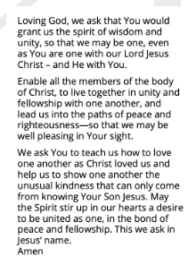
CLOSING PRAYER
Intentions?

Slide 53
announcements
Book Study starts next week! - Mere Christianity by C.S. Lewis
August 13 – September 24, 7-8:30p.m. ONLINE ONLY
In place of Thursday night Bible study and September’s monthly meeting
Doesn’t matter which edition you have ☺
Virtual Men’s Night – Tuesday, August 18th
Continuing Into the Breach
Treetop Adventures: Zipline and Ropes Course – Saturday, September 12th
NCC Podcast

Slide 54
References
All images taken from Google Images, Scripture passages from USCCB
Ascension Press – The Eastern Catholic Churches series
Alexandrian, Armenian, Byzantine, East Syriac, West Syriac, Latin
https://www.catholicnewsagency.com/resources/liturgy/rites/the-rites-of-the-catholic-church
https://geii.org/week_of_prayer_for_christian_unity/prayer_worship/prayer_cards.html
https://smellysheep.wordpress.com/2018/07/21/fellow-westerners-meet-the-eastern-churches-2/
https://chaldeanchurch.org/our-faith/what-is-the-chaldean-church/
Eparchy of Passaic website – Byzantine Spirituality, Iconography
The Catholic Talk Show – What Are the Eastern Rite Catholic Churches?
https://melkite.org/eparchy/bishop-john/what-are-the-differences-between-the-eastern-liturgies-st-john-and-st-basil
Rites of the Catholic Church in the United States

